Slide 1
Chapter 19: Networking on z/OS

Slide 2
Objectives
In this chapter, you will learn:
  An overview of the communication network model layers
  The software components of the z/OS Communications Server product
  The difference between a VTAM subarea and APPN network topology
  How the IP network can be used to transport data between SNA applications.
  Commonly used TCP/IP and VTAM commands

Slide 3
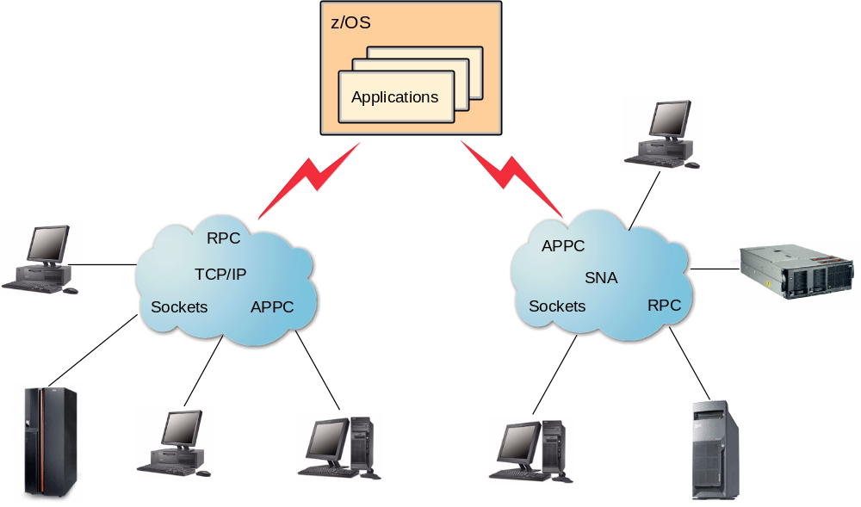
IBM Communications Server

Slide 4
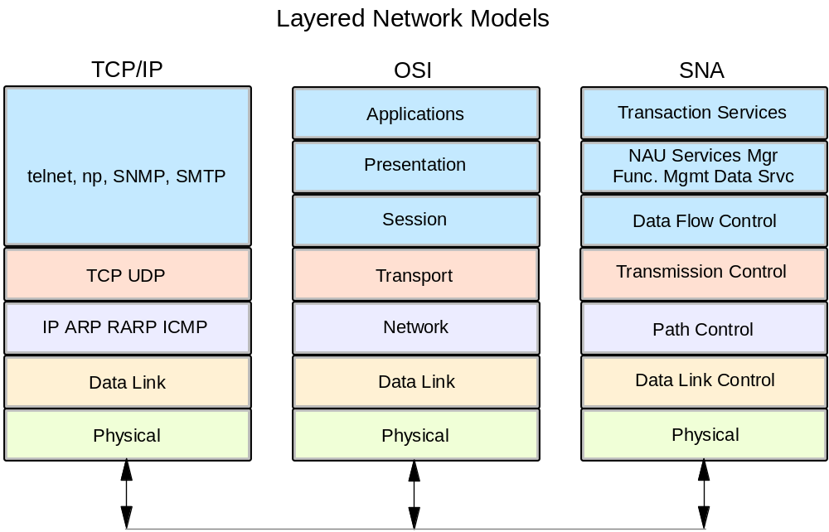
Open Systems Interconnect (OSI) network model

Slide 5
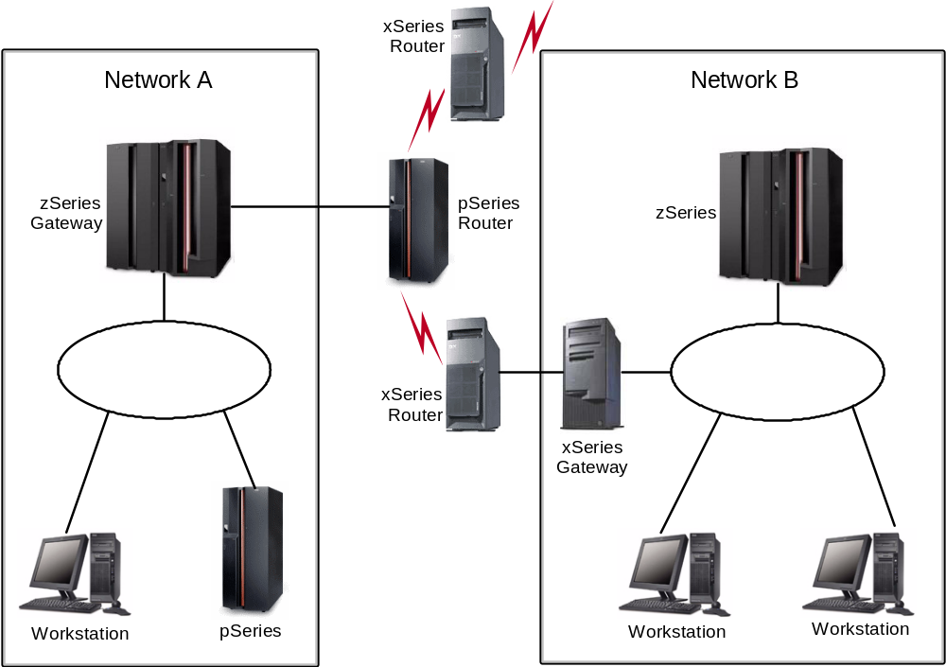
TCP/IP introduction

Slide 6
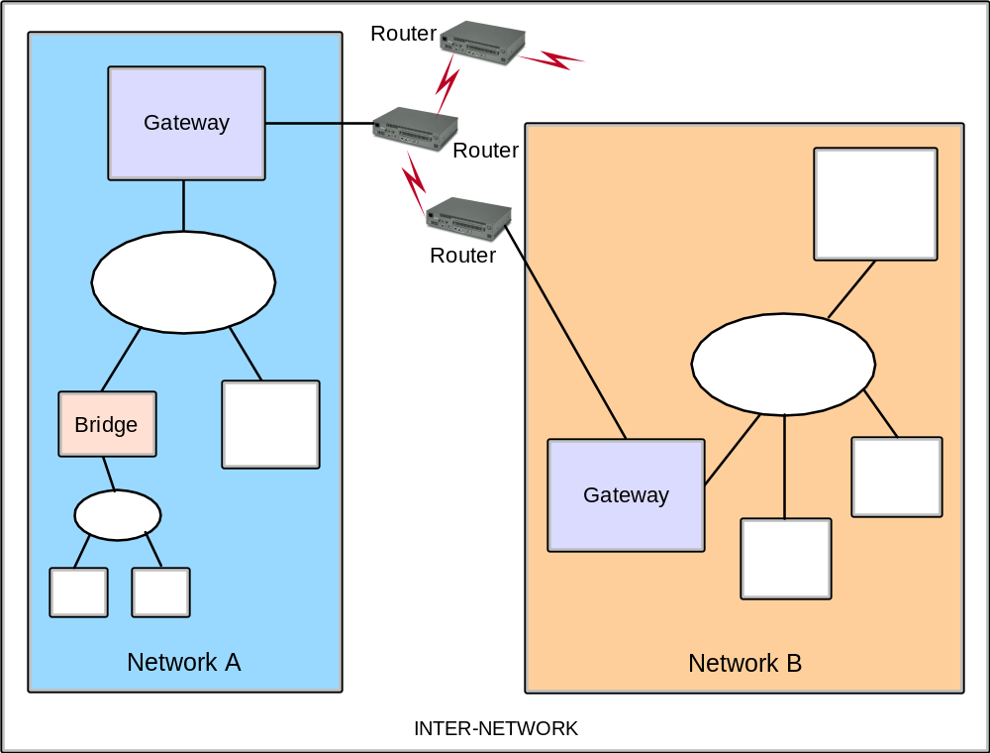
Interconnecting TCP/IP networks

Slide 7
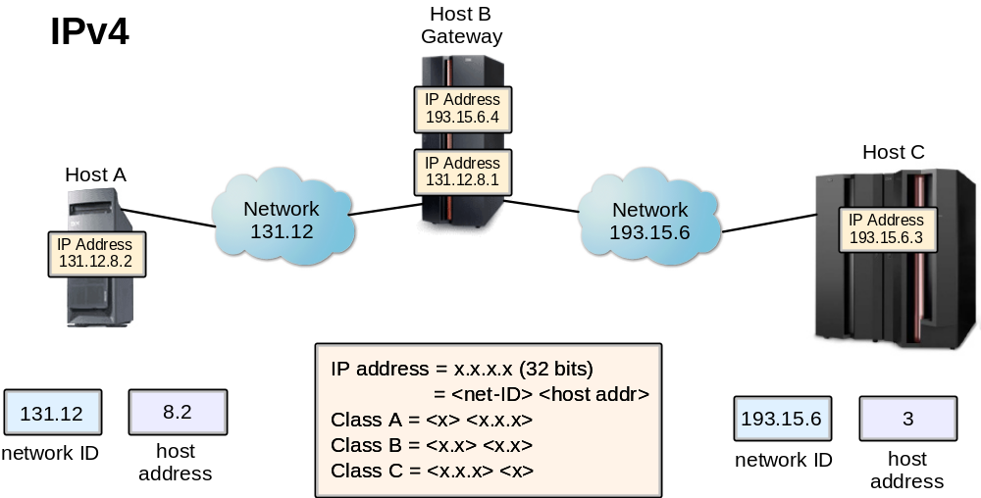
Internet addressing

Slide 8
TCP/IP commands
TCP/IP Commands can be entered
  TSO ready prompt
  ISPF Command Shell
  Prefixing the command with TSO on any ISPF command line.
    NETSTAT
    PING
    TRACERTE
    NSLOOKUP
    TELNET
    FTP
  z/OS UNIX shell prompt (prefix “o”=command)
    onetstat

Slide 9
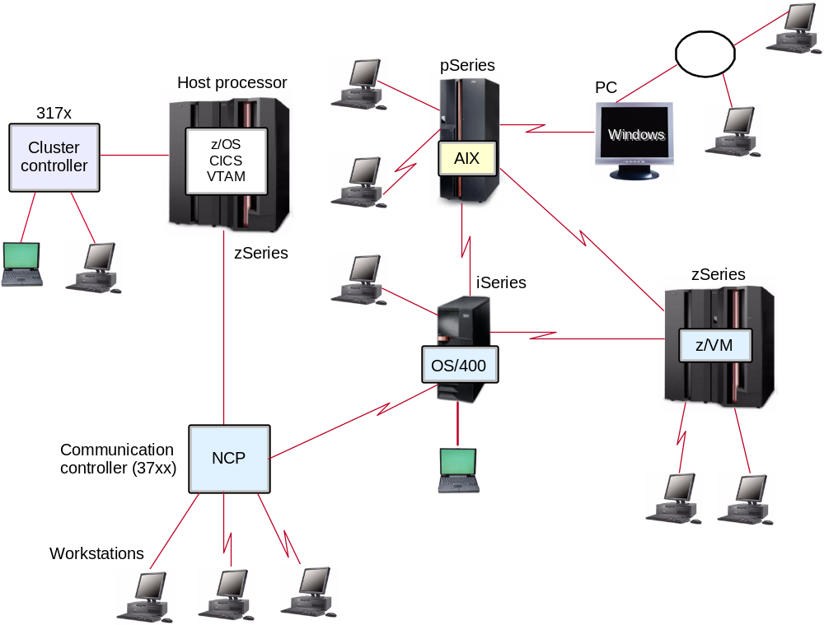
VTAM overview - the SNA environment

Slide 10
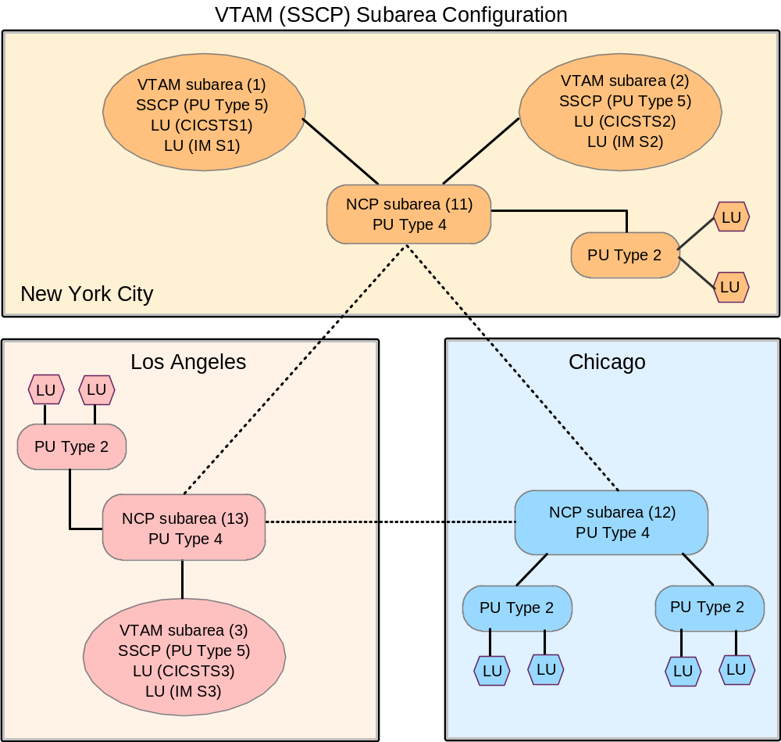
A pure VTAM subarea network

Slide 11
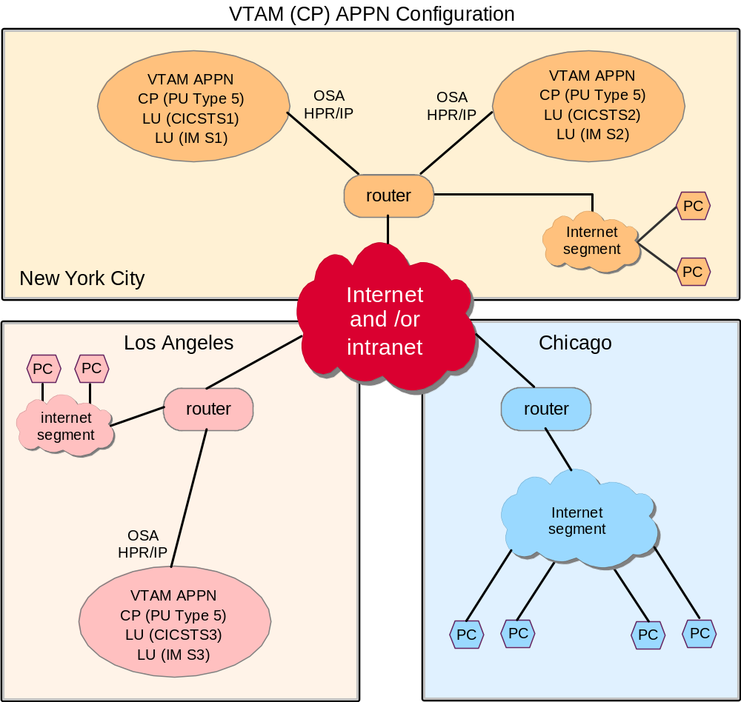
APPN topology

Slide 12
Common VTAM commands
D NET,VTAMOPTS Displays VTAM startup options.
D NET,CSM[,OWNERID=ALL] Displays communication storage usage.
D NET,APPLS Displays status of defined applications (ACBs).
D NET,MAJNODES Displays status of VTAM activated ATCCONxx members.
D NET,TOPO,LIST=SUMMARY Displays APPN topology information.
D NET,CPCP Displays status of APPN CP-CP sessions.
D NET,SESSIONS Displays status of subarea SSCP-SSCP sessions.
D NET,CDRMS Displays status of subarea cross domain resource managers.
D NET,EXIT Displays status of VTAM exit points.

Slide 13
Summary
In this chapter, you have learned:
  An overview of the communication network model layers
  Software components of the z/OS Communications Server product
  The difference between a VTAM subarea and APPN network topology
  How the IP network can be used to transport data between SNA applications.
  Commonly used TCP/IP and VTAM commands

Slide 14
Backup slides
Instructor slides with additional material

Slide 15
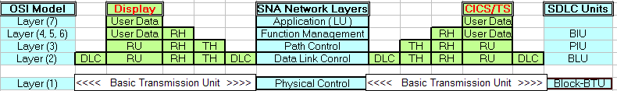
SDLC / CICS

